Slide 1
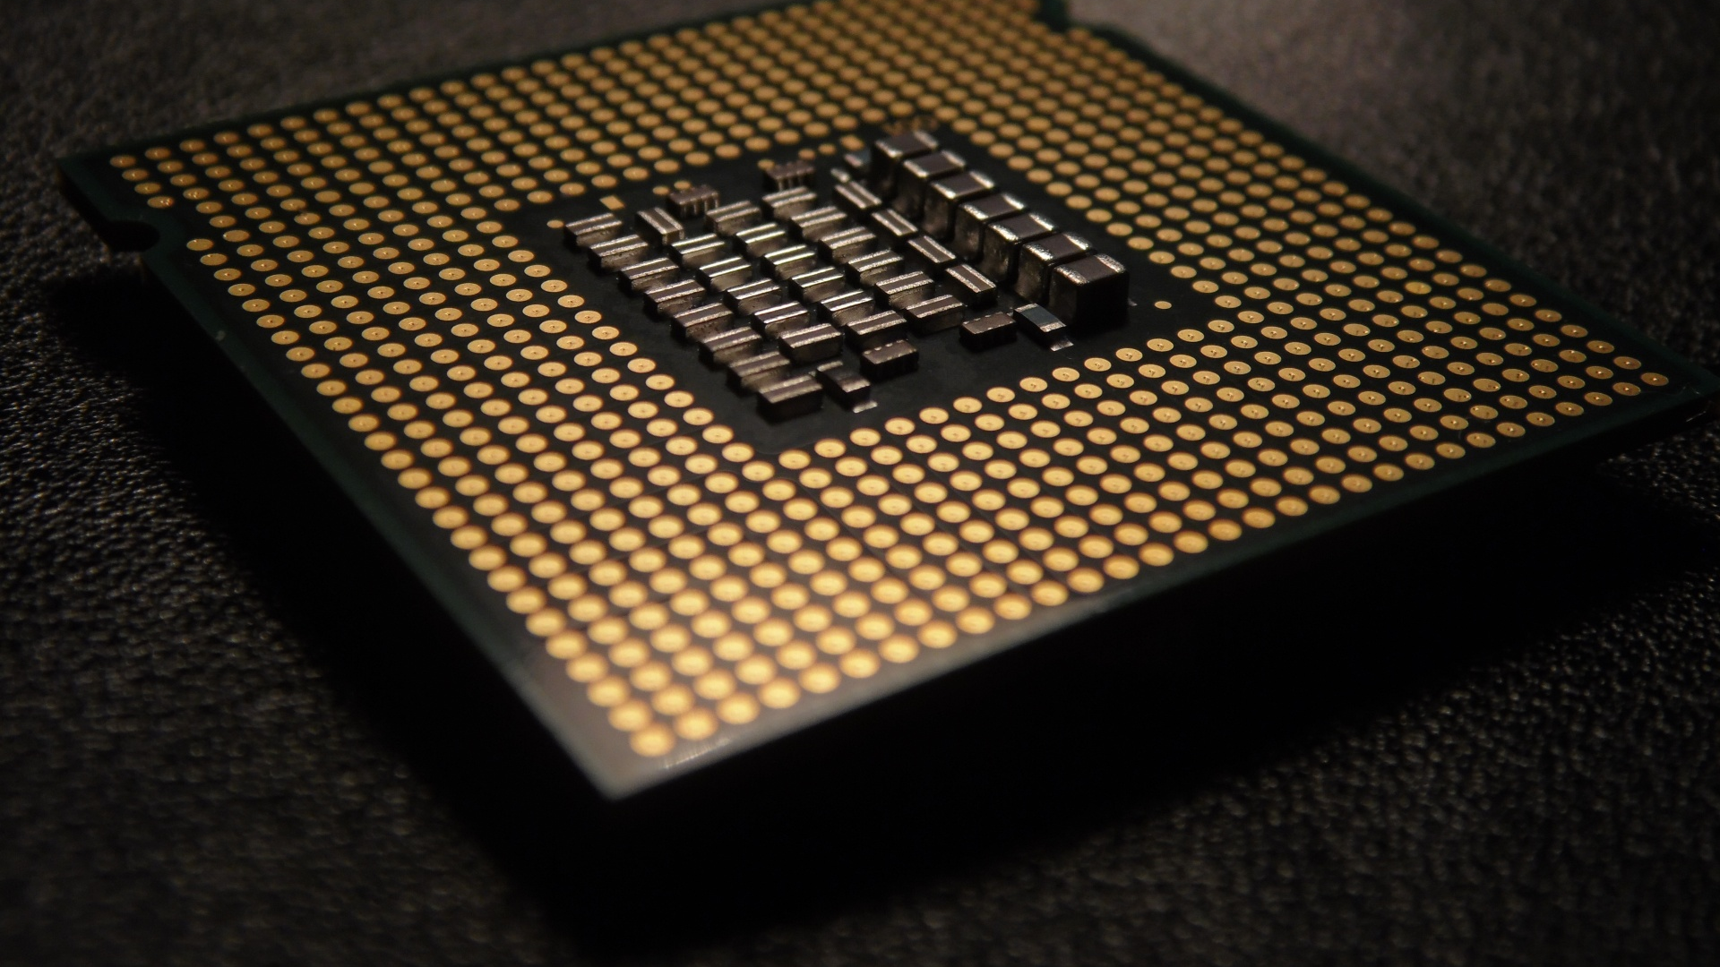
Profielwerkstuk
BFCPU
ArTUR TOPAL, Sv6b

Slide 2
Esoteric Programming Language (BF)
Morning Algorithm
You open your eyes.
You stand up.
Carefully go to the bathroom.
Take clothes off.
Start the water flow.
Etc.
BF Operations
+
-
>
<
.
,
[
]
(De-)increment the byte at the data pointer by one
(De-)increment the data pointer by one (to point to the next cell to the right).
see https://en.wikipedia.org/wiki/Brainfuck

Slide 3
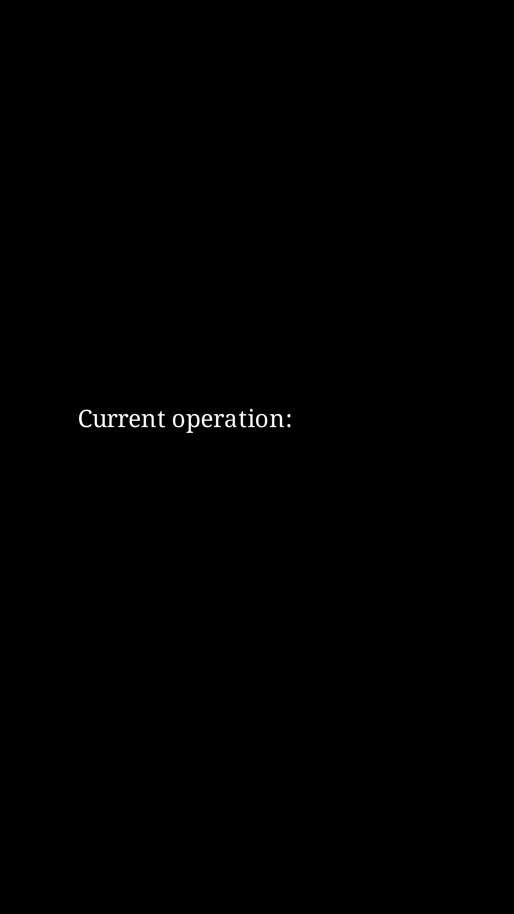
EXAMPLE 1
++>++>--<+--<+++>--<+++>-++>--<+-<+

Slide 4

ACTIVE EXAMPLE
+>+>+>-<

Slide 5

Aim
The aim of the project is creating CPU that can execute BF code using the simplest electronics components, like logic chips, resistors, capacitors, etc.
BF code => CPU => result

Slide 6
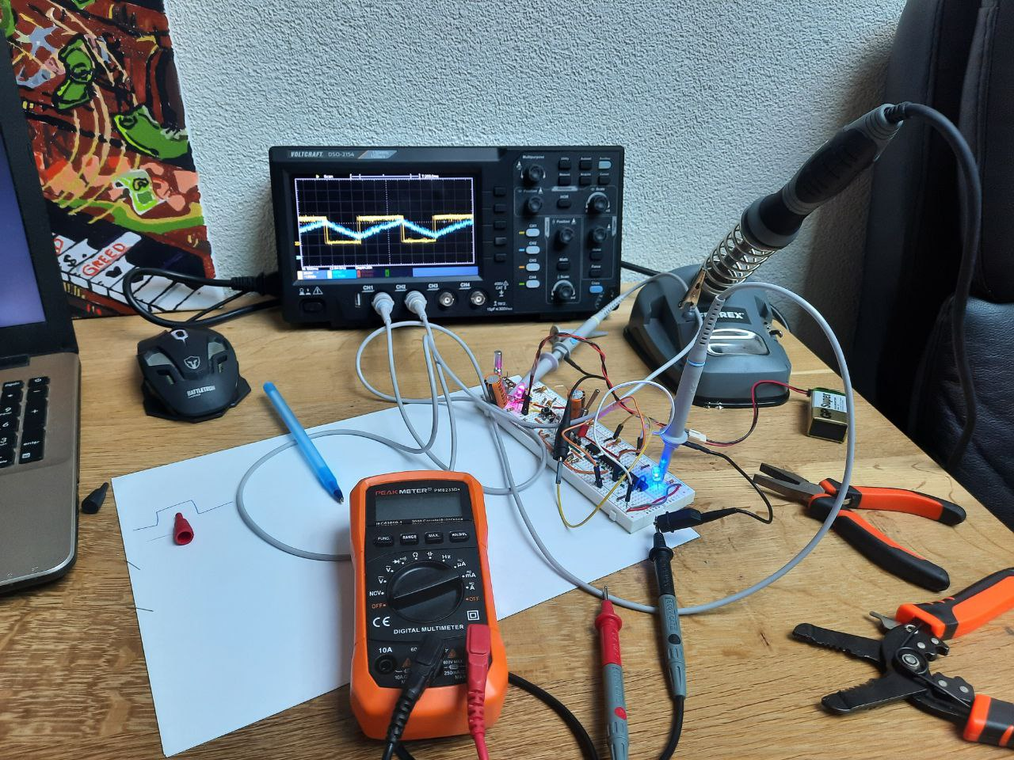
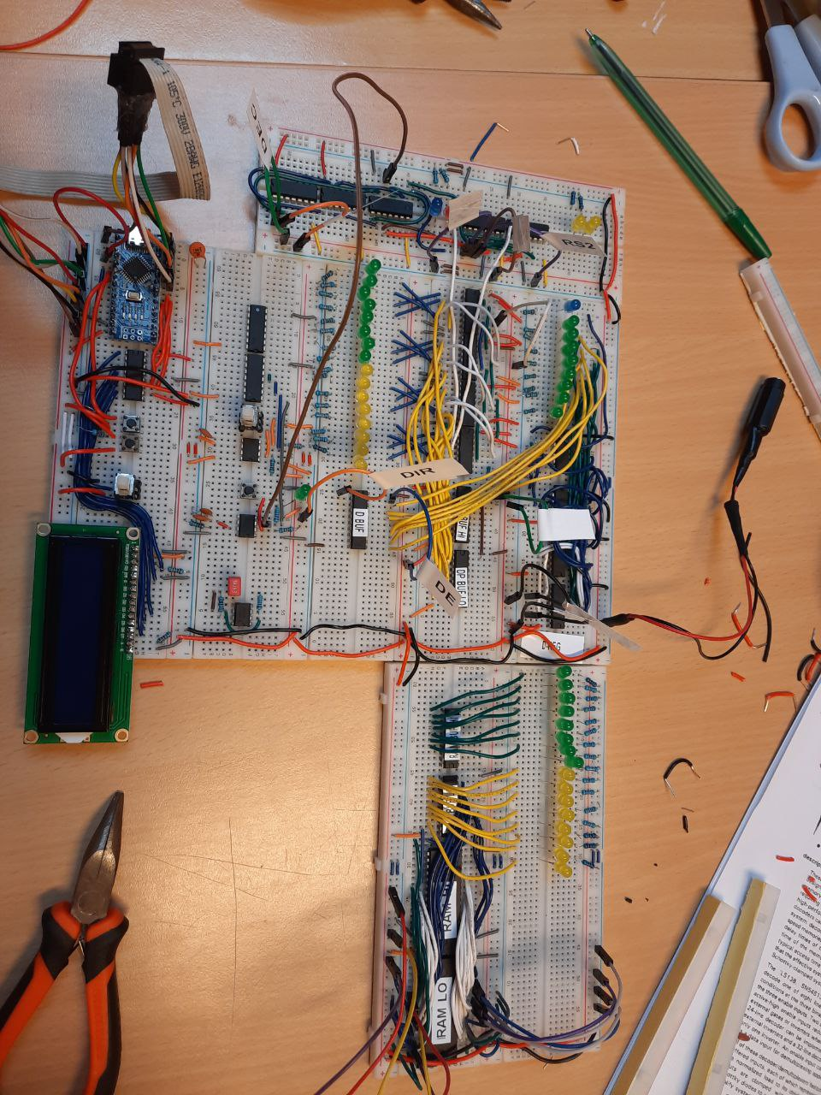

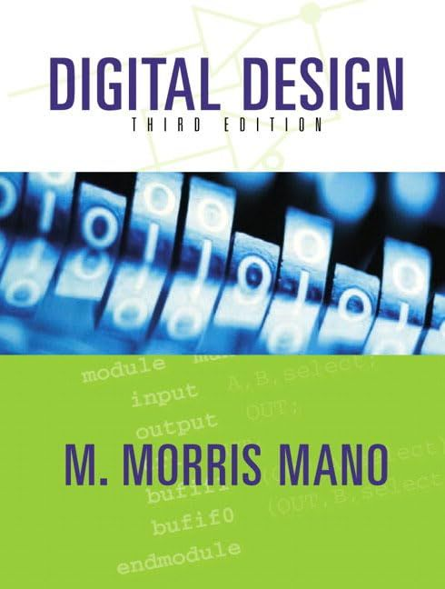
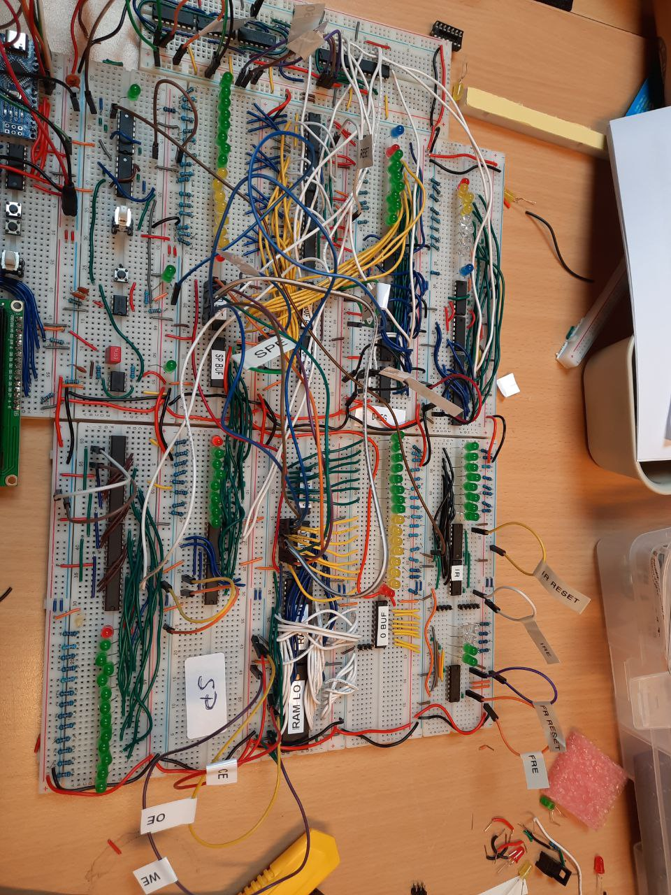
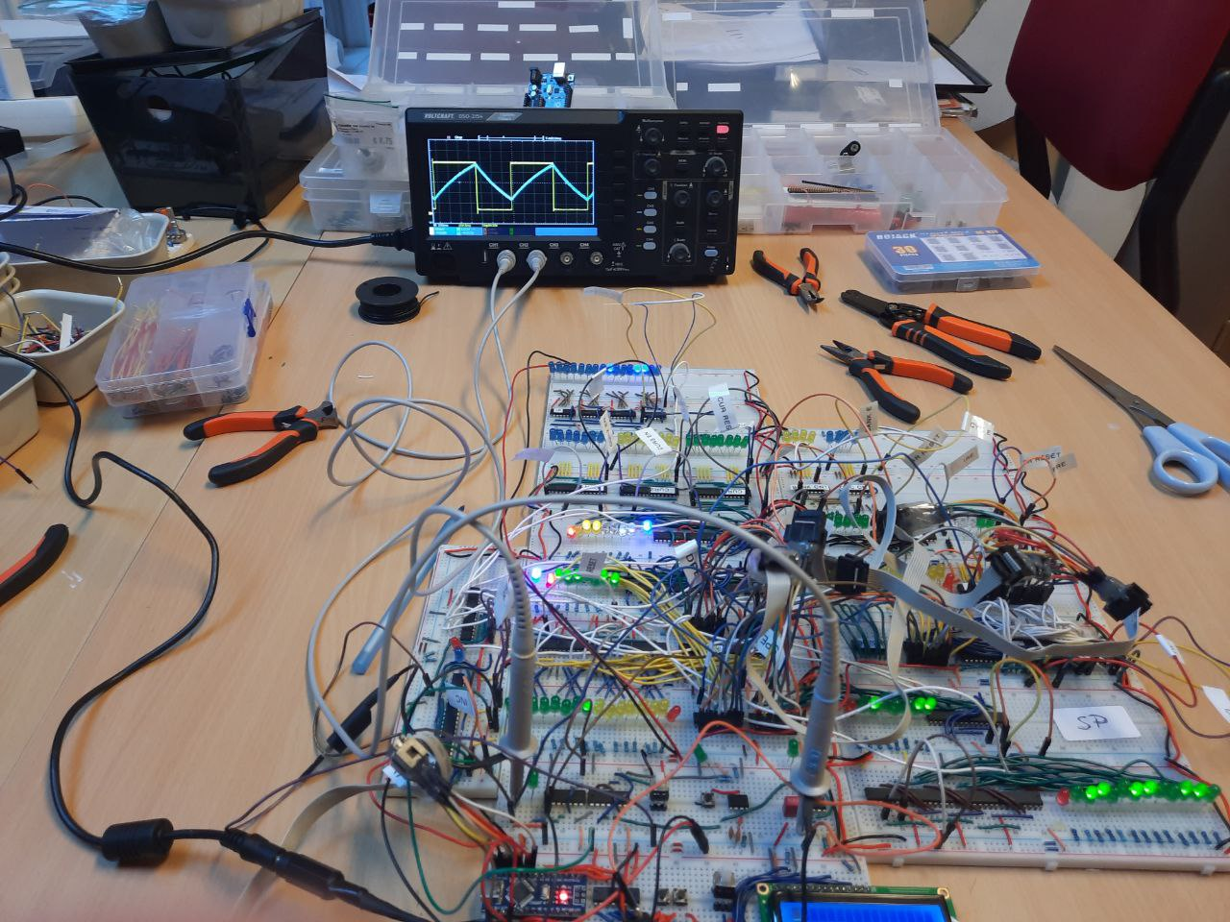
Results and Process

Slide 7
Next steps
Create the rest of the modules
Connect all the modules together
Test and Debug
Increase the Speed
Wanna follow? => https://github.com/jorenheit/bfcpu

Slide 8

End

